Slide 1



Language Basics
C Programming Language and Basic Structure
SoftUni
Training team
Software University
https://softuni.bg

Slide 2
Table of Contents
What is programming?
Language Basics
Basic Syntax
Write your first simple program
Console application with C
Running the program
Testing in Judge system
2

Slide 3

What is Programming?

Slide 4

What is Programming?
Writing down code which can then be used as an
instruction for the hardware to execute
We can write many different types of code,
one of which is imperative type
Multiple instructions form "computer program"
4

Slide 5

We Use Languages to Communicate

Slide 6

Communication
Добрый день!
Dobrý deň!
Добър ден!
Dobrý den!
Russian
Slovak
Bulgarian
Croatian

Slide 7


Communication
for(int i = 0; i <= 10; i++)
for(int i = 0; i <= 10; i++)

Slide 8


Communication
for(int i = 0; i <= 10; i++)
for(let i = 0; i <= 10; i++)

Slide 9
Programming Languages
There are different languages, however their purpose is pretty much the same
For example: C, C++, C#, Java, JavaScript, Python, PHP, …
You can write code anywhere but it is easier to do that inside IDE
9

Slide 10
Computer Program
Program == sequence of instructions
Contains data on which we execute different operations
Programs are written in text files
This text is also named source code
The source code is then being compiled to executable
Example: Program.c compiles to Program.exe
Some code can be executed without compilation
JavaScript code is interpreted not compiled
10

Slide 11
Integrated Development Environment
Integrated Development Environment
For C → Code::Blocks; for C# → Visual Studio; for Java → IntelliJ
Download and install Code::Blocks
https://sourceforge.net/projects/codeblocks/files/Binaries/17.12/Windows/codeblocks-17.12mingw-setup.exe/download Cross-platform application with open source (Linux, Mac OS, Windows)

Slide 12

Language Basics
Program Structure

Slide 13
C Programming Language
General-purpose imperative procedural language
Supports static type system
Prevents unintended operations
Efficiently maps to machine instructions
Used in applications previously coded in assembly
Used in operating systems
Can be executed on any hardware from embedded systems to supercomputers
13

Slide 14
C Philosophy
Developed by Dennis Ritchie in Bell Labs
Used to rewrite the kernel of UNIX OS
Gained popularity and was standardized in 1989 by ANSI and afterwards by IOS
Latest version of the standard is C18
Supports pointer to an object
Supports low level memory management
14

Slide 15
Program Structure
Each C program has structure which benefits in certain ways:
Easier to write
Easier to read
Easier to maintain
Easier to extend
For now all functionalities of your programs should be inside the main function

Slide 16
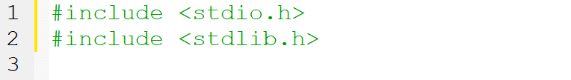
#Include
Is a simple directive
Whenever a compilation has been run there is something called preprocessor which is mostly another program
This include code from other files inside your source code

Slide 17
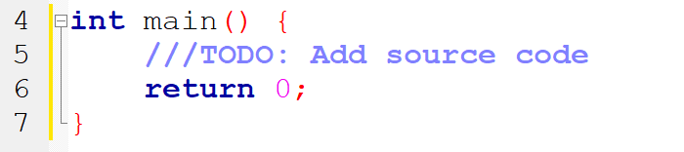
Main Function
C programs start from main function:
It is the entry point of the application
It returns the result of the program to the system
The code of the program is written between the curly brackets, the last line is usually the return statement

Slide 18
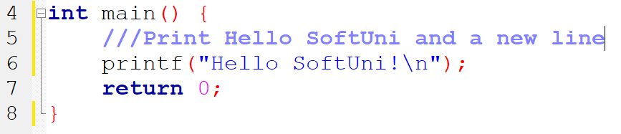
Statements & Comments
Statement: code to be executed
Contains C code and ends with a ;
Comments (text ignored by the compiler)
Comment is market with // or /// (this one gives fancy color)
Comment
A statement
Another statement usually one per line

Slide 19

Basic Syntax
Declaring and Initializing Variables

Slide 20
Declaring and Initializing Variables
Defining and Initializing variables
Example:
{data_type} {identifier} = {value};
Variable identifier
int number = 5;
Data type
Variable value
20

Slide 21
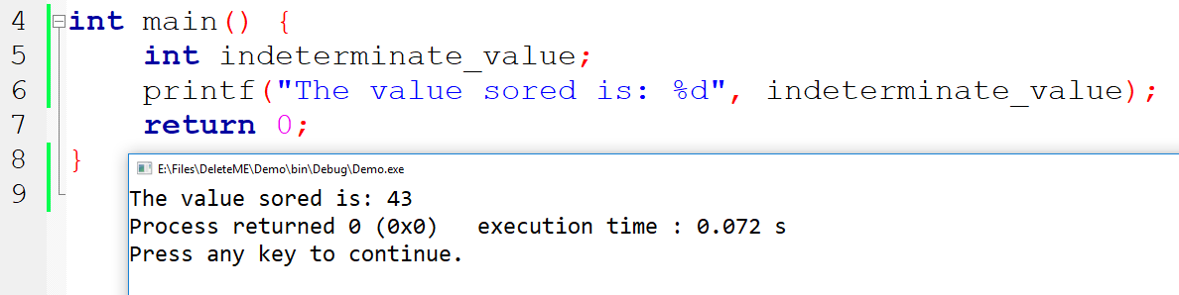
Uninitialized Variables
Be careful whenever a variable is being declared without initialization the value stored is indeterminate doing so is bad practice
21

Slide 22
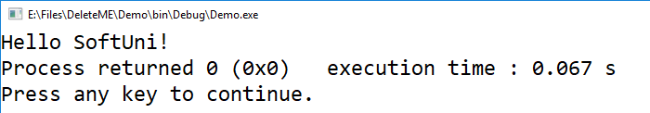
Basic Output
C provides functions for output operations
Those functions are defined in <stdio.h>
For this course our output destination will be the console
There are input functions as well but we will get to them in the next lesson
22

Slide 23
Printf();
This function is shared in many languages
Writes text between quotation marks "Text"
Variables can be inserted inside that text
Insert other text with %s
Insert integer number with %d
printf("%s", "Hello"); //Hello
printf("The answer is %d", 42); //The answer is 42

Slide 24
Simple Console Application
Live Demo

Slide 25
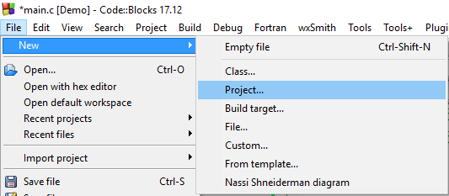
Console Application
Run Code::Blocks
Create new project [File]→ [New] → [Project]

Slide 26
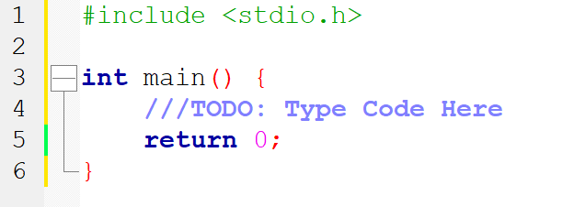
Writing a Program
Source code is written inside functions such as main()
Function has definition placed between the curly brackets { }
Commonly used good practice is to write the code in well formatted text file it makes it easy to read, write and maintain over time

Slide 27
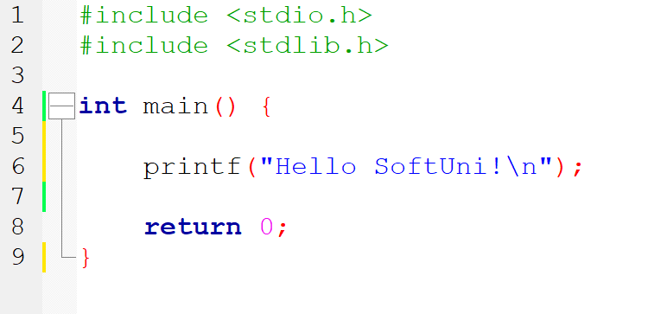
Writing a Program
First console application
Core input and output functions
Program entry point
Printing function
Returning 0 means the execution was successful
27

Slide 28
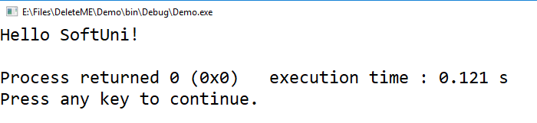
Run the Program
To start the program press [F9]
This starts the compilation of the code
If there are no compilation errors (something preventing
the program from compilation) you will see this:

Slide 29
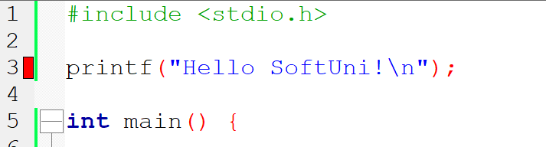
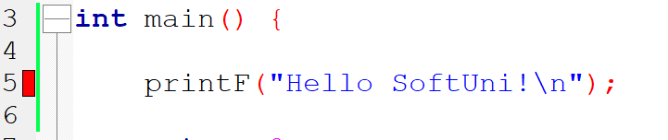
Some Compilation Errors in C
Writing code outside the main(){} function:
Misspelling standard functions names:
29

Slide 30
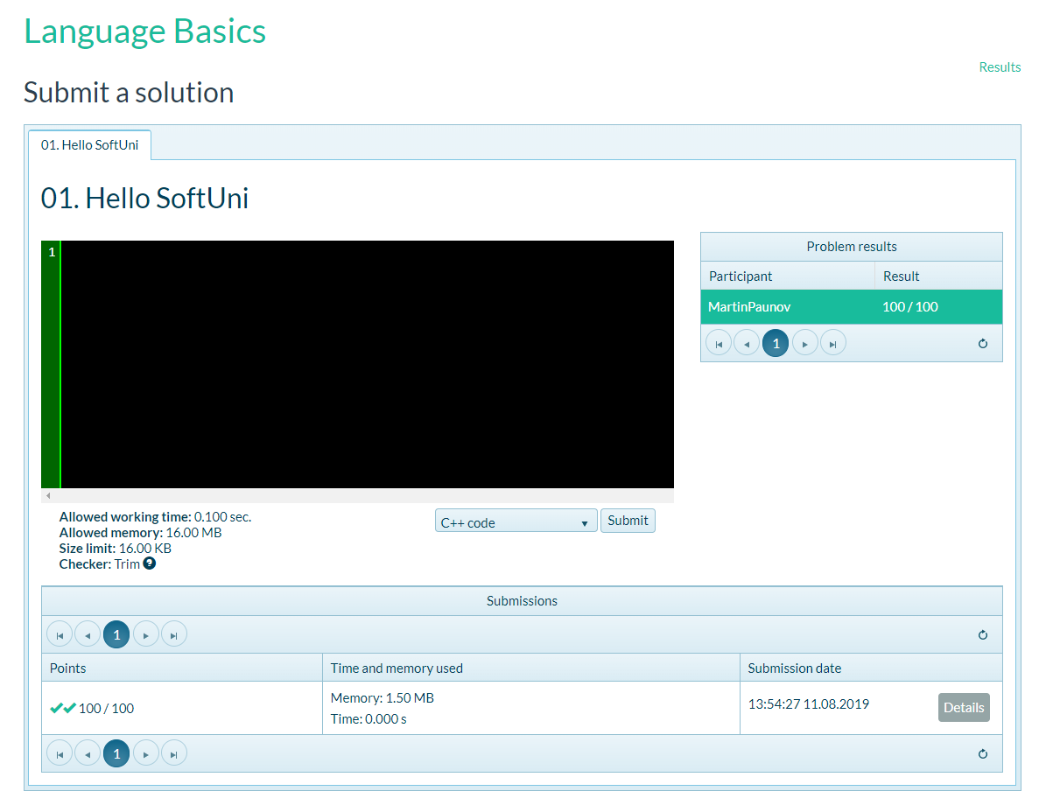
Testing in Judge
The web application for testing - Judge:
https://judge.softuni.bg/Contests/Practice/Index/2233#0

Slide 31
Summary
What is programing
Sequence of statements
Code which then translates to machine language
C Programming language
Program structure
C Syntax
Developing console applications
Testing in Judge

Slide 32
Questions?
Notes:
32

Slide 33












SoftUni Diamond Partners

Slide 34




SoftUni Organizational Partners

Slide 35
Trainings @ Software University (SoftUni)
Software University – High-Quality Education, Profession and Job for Software Developers
softuni.bg, softuni.org
Software University Foundation
softuni.foundation
Software University @ Facebook
facebook.com/SoftwareUniversity
Software University Forums
forum.softuni.bg
35
Notes:
35

Slide 36

License
This course (slides, examples, demos, exercises, homework, documents, videos and other assets) is copyrighted content
Unauthorized copy, reproduction or use is illegal
© SoftUni – https://softuni.org
© Software University – https://softuni.bg
Notes:
36

